Slide 1
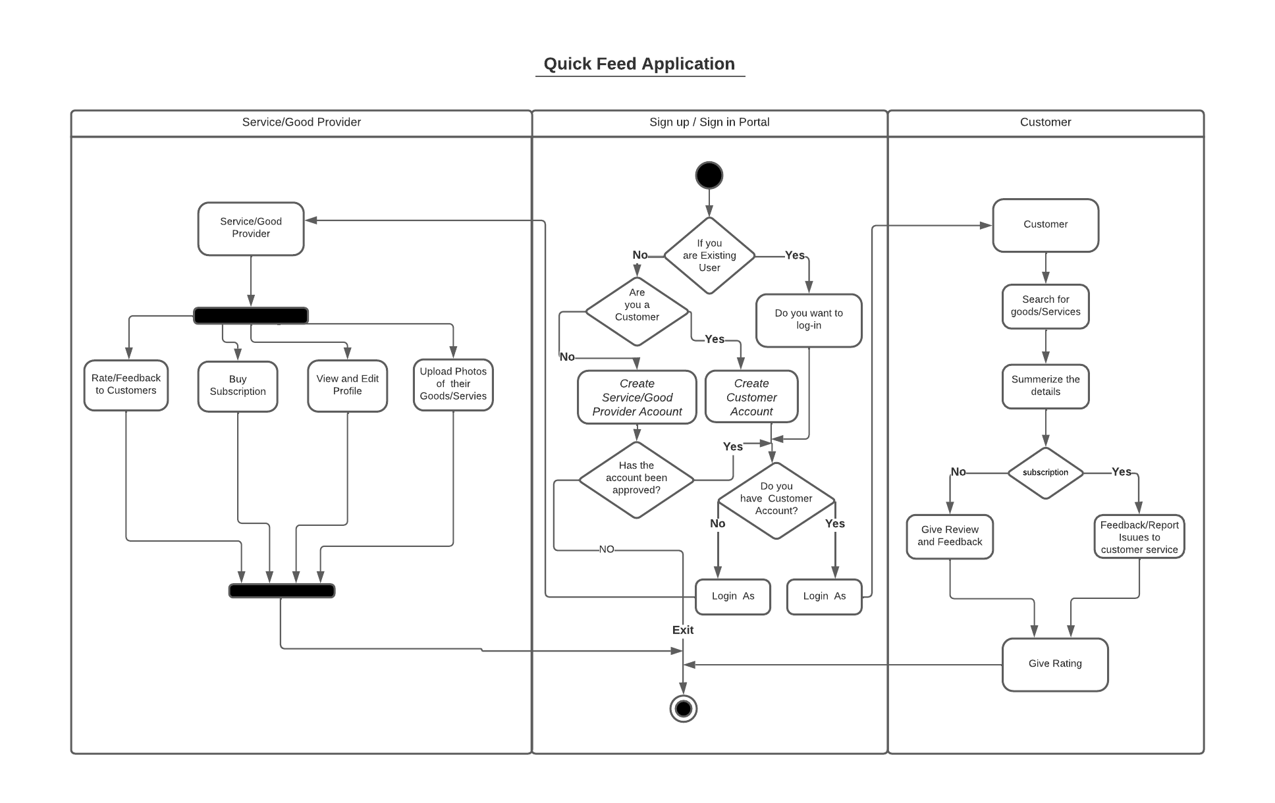
Activity Diagram - Quick Feed Application

